Slide 1


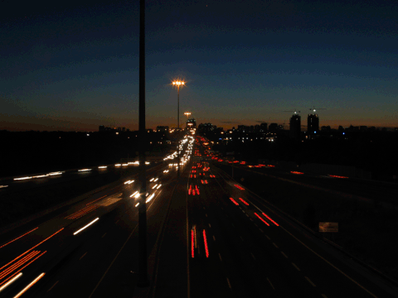

ROAD CRASHES IN CHICAGO
Sebastiano Florio
Master’s Degree in Data Science for Management
Big Data Analytics
Academic Year 2020-2021

Slide 2
DATASETS
CRASHES
CRASH_RECORD_ID
CRASH_DATE
WEATHER_CONDITION
TRAFFICWAY_TYPE
ALIGNMENT
ROAD_DEFECT
PRIMARY_CONTRIBUTORY_CAUSE
MOST_SEVERE_INJURY
STREET_NAME
BEAT_OF_OCCURENCE
LATITUDE
LONGITUDE
The source of the dataset is https://data.cityofchicago.org/.
Crashes.csv contains informations about each traffic crushes.
People.csv contains informations about people involved in a crash.
Geospatial dataset that contains the boundaries of each Police
Department of Chicago.
PEOPLE
PERSON_ID
PERSON_TYPE
CRASH_RECORD_ID
SEX
AGE
SAFETY_EQUIPMENT
EJECTION
INJURY_CLASSIFICATION
PHYSICAL_CONDITION
POLICE DEPARMENT
BEAT_NUMBER
GEOMETRY

